Slide 1
Limits of Sequences of Real Numbers
Sequences of Real Numbers
Limits through Definitions
The Squeeze Theorem
Using the Squeeze Theorem
Monotonous Sequences

Slide 2
VIDEO and INTERNET SUPPORT FOR THIS LECTURE
Explains the main points in THIS slide show:
http://www.youtube.com/watch?v=yBE1WApSpV4
Examples:
http://www.youtube.com/watch?v=hc64LUtPjP0
Theory through examples:
http://archives.math.utk.edu/visual.calculus/6/sequences.3/index.html

Slide 3
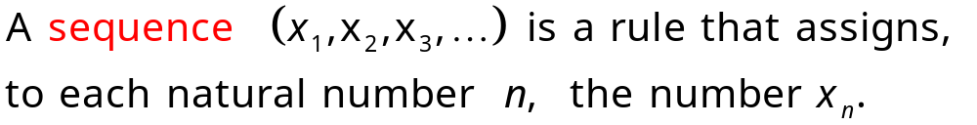
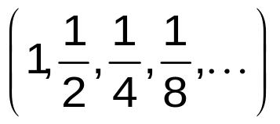
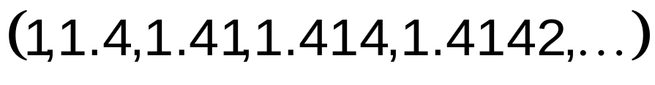
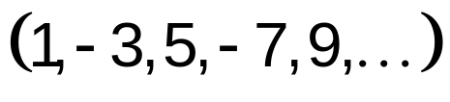
Sequences of Numbers
Definition
Examples
1
2
3

Slide 4
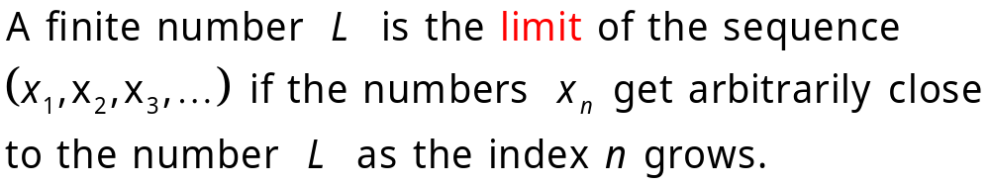
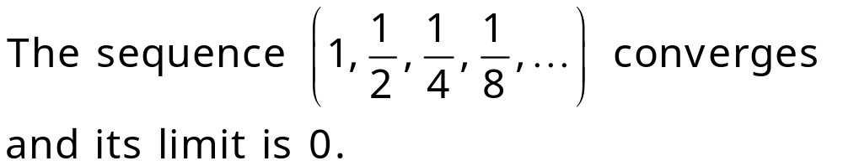
Limits of Sequences
Definition
If a sequence has a finite limit, then we say that the sequence is convergent or that it converges. Otherwise it diverges and is divergent.
Examples
1
0

Slide 5
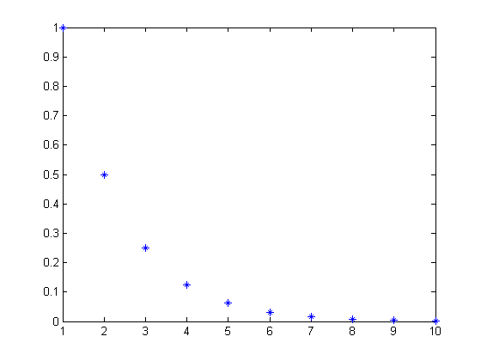
0

Slide 6
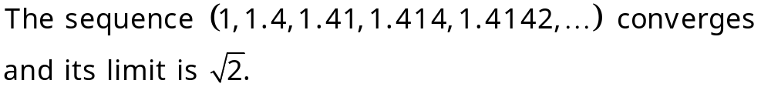
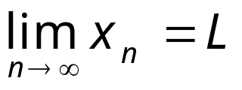
Limits of Sequences
2
3
The sequence (1,-2,3,-4,…) diverges.
Notation

Slide 7
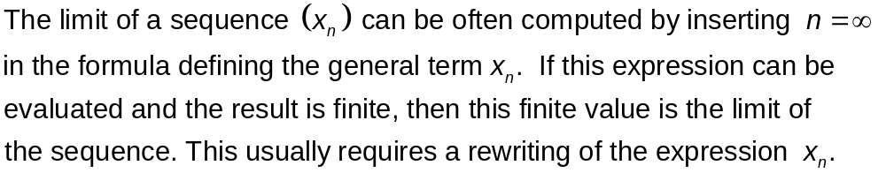
Computing Limits of Sequences (1)

Slide 8
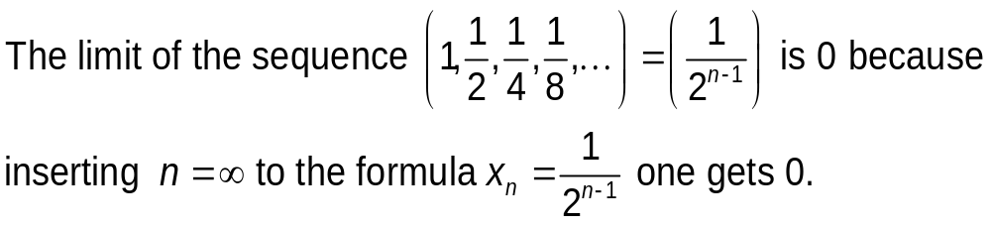
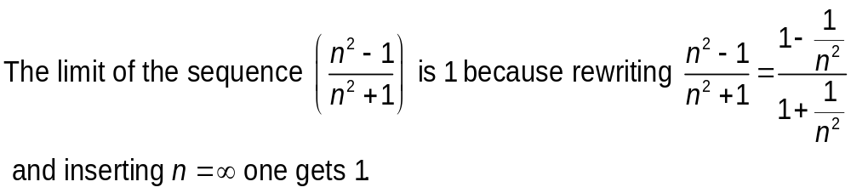
Computing Limits of Sequences (1)
Examples
1
2
1
0
n²

Slide 9
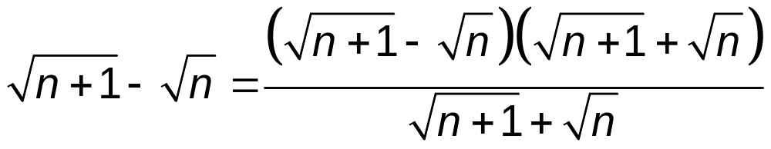
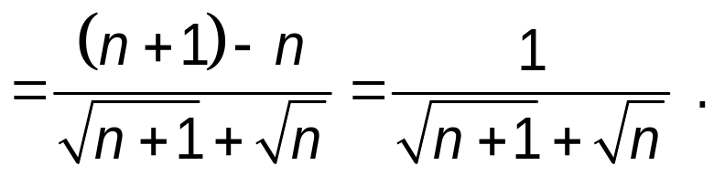
Computing Limits of Sequences
Examples continued
3

Slide 10
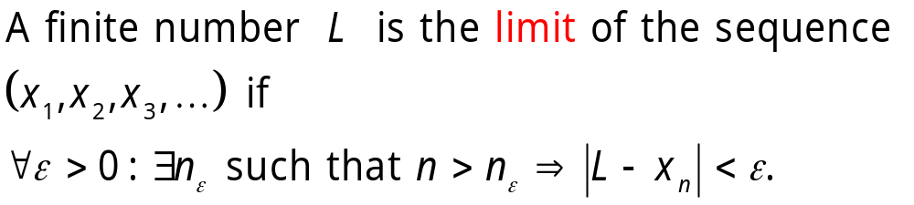
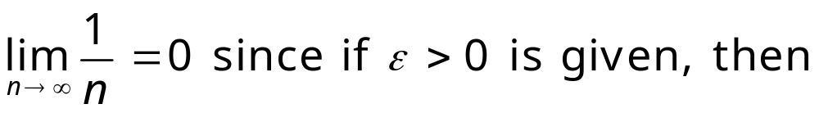
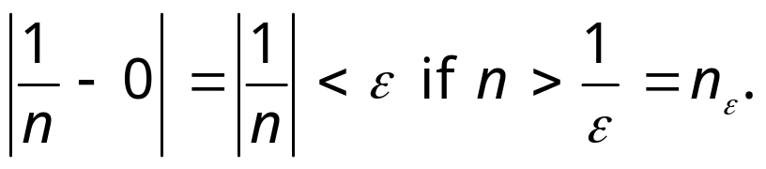
Formal Definition of Limits of Sequences
Definition
Example

Slide 11
Visualizing the formal definition of a sequence
http://archives.math.utk.edu/visual.calculus/6/sequences.3/index.html

Slide 12
Immediate consequence of the formal definition of a sequence
Theorem
Every convergent sequence is bounded.
Proof
Suppose that lim x_{n}=L . Take ϵ = 1 (any number works). Find N 1 so that whenever
n > N1 we have x_{n} within 1 of L. Then apart from the finite set { a₁, a₂, ... , a_{N}} all the terms of the sequence are bounded by L+ 1 and L - 1.
So an upper bound for the sequence is max {x₁ , x₂ , ... , x_{N} , L+ 1 }. Similarly one can find a lower bound.

Slide 13
The Limit of a Sequence is UNIQUE
Theorem
The limit of a sequence is UNIQUE
Proof
Indirectly, suppose, that a sequence would have 2 limits, L1 and L2. Than for a given ε
∃N 1 ∈N:∀n∈N:n>N 1 :|L1 −xn|<ϵ
∃N 2 ∈N:∀n∈N:n>N 2 :| L2 −xn|<ϵ
if N=max{N 1 ,N 2 }, xn would be arbitrary close to L1 and arbitrary close to L2 at the same, it is impossible-this is the contradiction (Unless L1 =L2)

Slide 14
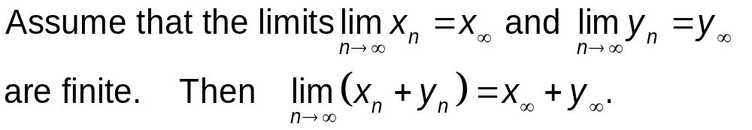

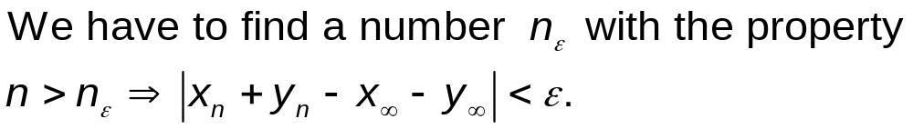
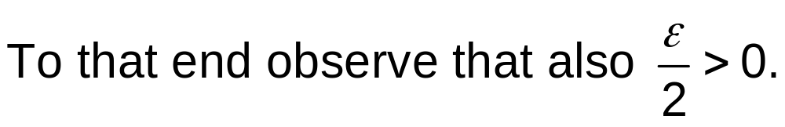
Limit of Sums
Theorem
Proof

Slide 15
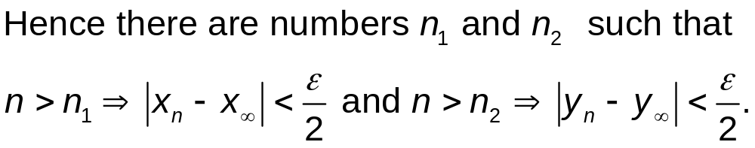
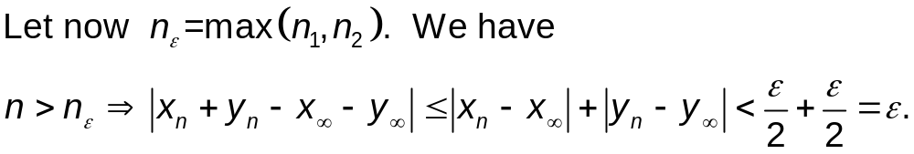
Limit of Sums
Proof
By the Triangle Inequality

Slide 16
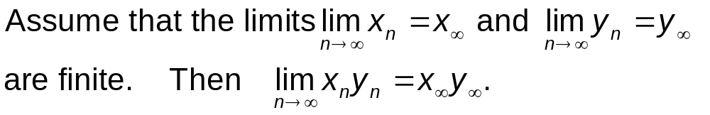
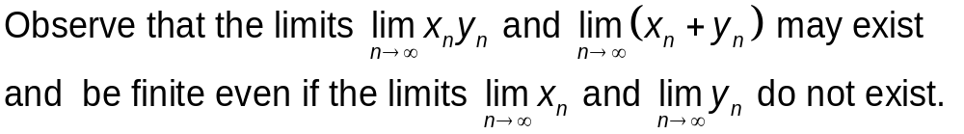
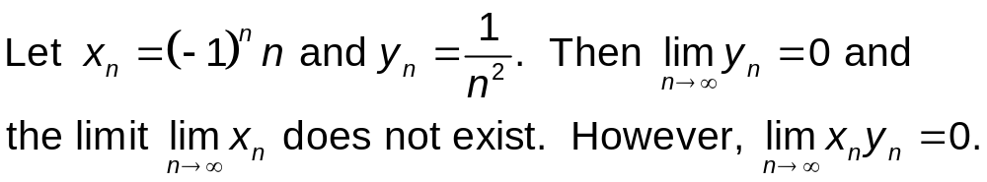
Limits of Products
The same argument as for sums can be used to prove the following result.
Theorem
Remark
Examples

Slide 17
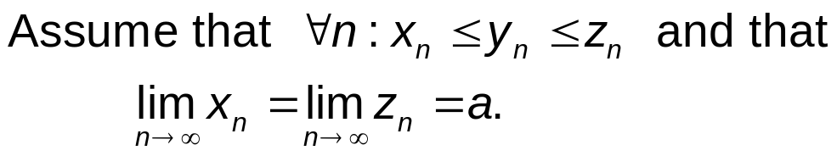
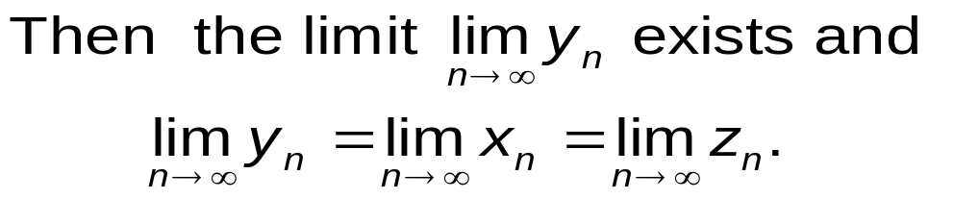
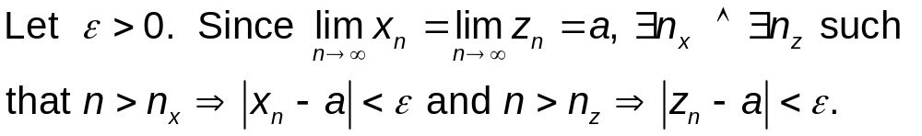
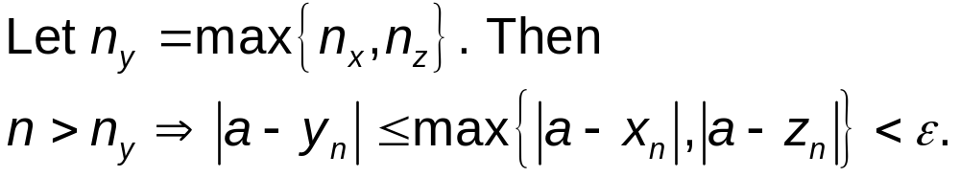

Squeeze Theorem for Sequences
Theorem
Proof

Slide 18
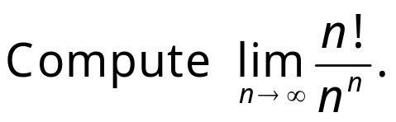
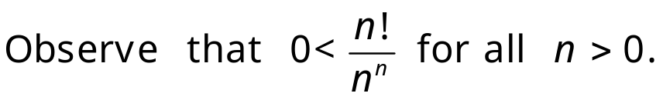
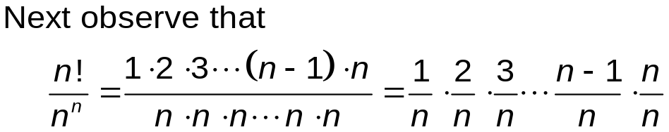
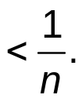
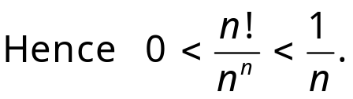
Using the Squeeze/Pinching Theorem
Example
Solution
This is difficult to compute using the standard methods because n! is defined only if n is a natural number.
So the values of the sequence in question are not given by an elementary function to which we could apply tricks like L’Hospital’s Rule.
Here each term k/n < 1.

Slide 19
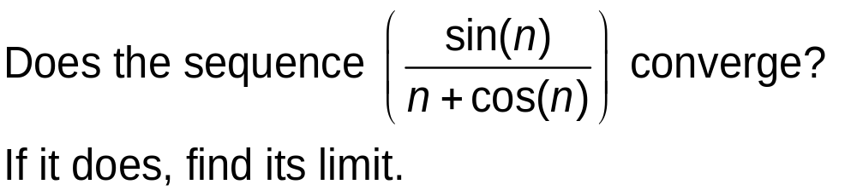
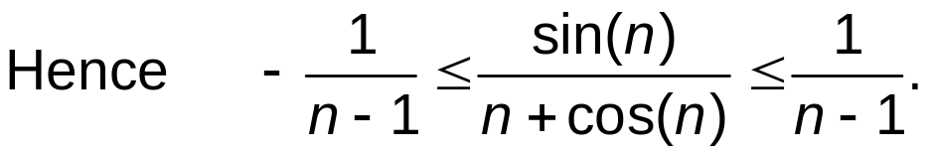
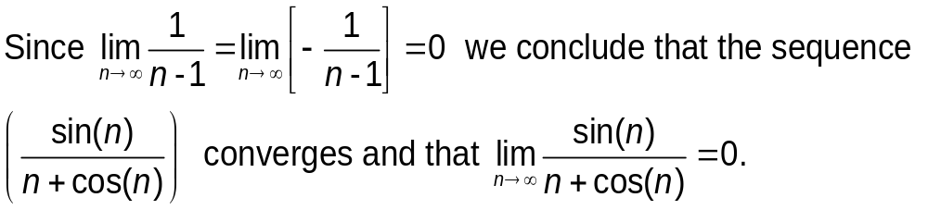
Using the Squeeze Theorem
Problem
Solution

Slide 20
Monotonous Sequences
Definition
A sequence (a₁,a₂,a₃,…) is increasing if a_{n} ≤ a_{n+1} for all n.
The sequence (a₁,a₂,a₃,…) is decreasing if a_{n+1} ≤ a_{n} for all n.
The sequence (a₁,a₂,a₃,…) is monotonous if it is either increasing or decreasing.
The sequence (a₁,a₂,a₃,…) is bounded if there are numbers M and m such that m ≤ a_{n} ≤ M for all n.
Theorem
A bounded monotonous sequence always has a finite limit.
Observe that it suffices to show that the theorem for increasing sequences (a_{n}) since if (a_{n}) is decreasing, then consider the increasing sequence (-a_{n}).

Slide 21

Monotonous Sequences
Theorem
A bounded monotonous sequence always has a finite limit.
Proof
Let (a₁,a₂,a₃,…) be an increasing bounded sequence.
Then the set {a₁,a₂,a₃,…} is bounded from the above.
By the fact that the set of real numbers is complete,
s=sup {a₁,a₂,a₃,…}
is finite.
Claim

Slide 22



Monotonous Sequences
Theorem
A bounded monotonous sequence always has a finite limit.
Proof
Let (a₁,a₂,a₃,…) be an increasing bounded sequence.
Let s=sup {a₁,a₂,a₃,…}.
Claim
Proof of the Claim

Slide 23
SUMMARY
1. Notion of a sequence
2. Notion of a limit of a sequence
3. The limit of a convergent sequence is unique.
4. Every convergent sequence is bounded.
5. Any bounded increasing (or decreasing) sequence is convergent.
Note that if the sequence is increasing (resp. decreasing), then the limit is the least-upper bound (resp. greatest-lower bound) of the numbers

Slide 24
SUMMARY
6. If two sequences are convergent and we compose their +, -, *. /, 1/.. then the limit of this composed sequence exists and is the +, -, *. /, 1/..of the original limiting values.
7. Squeeze/Pinching theorem

